Slide 1
GraphX: An Apache Spark Component
EN.605.788 Final Project
Tanner Amundsen

Slide 2
Introduction to GraphX

Slide 3
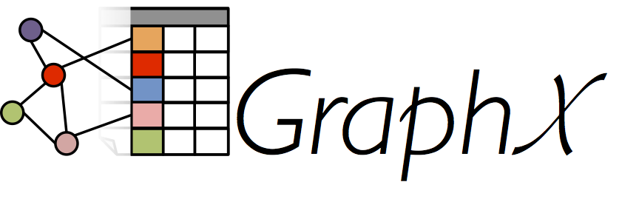
Introduction to GraphX
“GraphX is Apache Spark’s API for graphs and graph-parallel computation”
Spark.apache.org/graphx
Developed in 2014 at Berkely, donated to the Apache Software Foundation
Uses Spark’s foundational data structures as its backbone
Built for flexibility and speed. Especially for parallel and recursive algorithms
e.g. PankRank, Pregel API

Slide 4
Introduction to GraphX: Graph Class
Graph: The fundamental data structure of GraphX
Extends Serializable (like the RDD class)
Immutable, distributed, fault-tolerant
Parameterized over the vertex (VD) and edge (ED) types
e.g.
class Graph[VD, ED] {
val vertices: VertexRDD[VD]
val edges: EdgeRDD[ED]
}
Supports user defined properties attached to vertex and edge objects
Extends RDD[(VertexID, VD)]
Extends RDD[Edge[ED]]
Notes:
Serializable interface
Resilient Distributed Datasets (RDDs):
Graphs are at their core – an ordered pair of sets.
First set: vertices
Second set: edges
These vertex and edge types can be augmented by the programmer to include properties. For example, if each vertex represented a version, you could define a class with properties like their name, age, job etc.

Slide 5
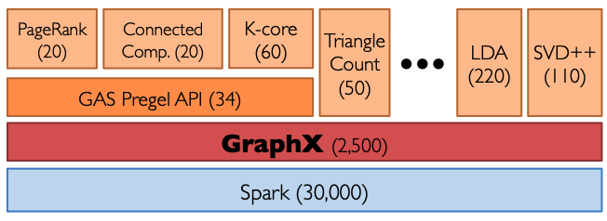
Introduction to GraphX: How is it Built to Handle Big Data?
Distributed processing across cluster
In-memory storage for intermediate computations
Resilient Distributed Datasets (RDDs)
Lazy Evaluation
Notes:
1. Distributed Processing:
Spark distributes data processing tasks across a cluster of machines. This allows it to leverage the combined processing power and memory of multiple nodes to handle massive datasets that wouldn't fit on a single machine.
2. . In-Memory Computation (when possible):
Spark prioritizes storing frequently accessed data in the memory of worker nodes. This in-memory processing significantly boosts performance compared to traditional disk-based processing, especially for iterative algorithms.
3. Resilient Distributed Datasets (RDDs):
Spark represents data as Resilient Distributed Datasets (RDDs). RDDs are fault-tolerant data structures that can be partitioned and stored across the cluster. They also allow for automatic data recovery in case of node failures.
4. Lazy Evaluation:
Spark utilizes lazy evaluation, where transformations are only applied when needed. This allows for efficient optimization of query plans and reduces unnecessary computations.

Slide 6
Installation & Setup

Slide 7
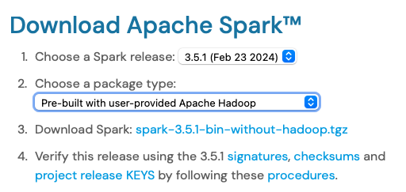

Installation: Spark, Scala, & sbt
GraphX is included as a module of Spark
GraphX support for Java, Python, and Scala
I found it easiest to code in Scala
Scala script file can be run using the spark-submit command
sbt is an open source build tool created for Scala and Java projects
A lot like Maven
I downloaded the latest version as a .tgz file

Slide 8
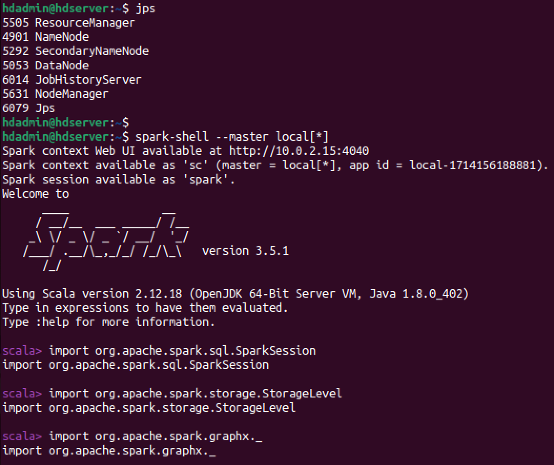
Setup: GraphX in the Spark Shell
start-dfs.sh
start-yarn.sh
mapred –-daemon start historyserver
spark-shell --master local[*]
Or --master yarn
Notes:
You can run graphX methods in a spark shell

Slide 9
Setup: Standalone Applications
./build.sbt
name := "facebook_graph"
version := "1.0.0"
scalaVersion := "2.12.12"
libraryDependencies ++= Seq(
"org.apache.spark" % "spark-core_2.12" % "3.5.1" % "provided",
"org.apache.spark" % "spark-sql_2.12" % "3.5.1" % "provided",
"org.apache.spark" % "spark-graphx_2.12" % "3.5.1" % "provided"
)
You can create standalone applications saved as assembly .jars
sbt bundles your code and dependencies together
sbt build
Launch your application using spark-submit
./bin/spark-submit
--class <main-class>
--master <master-url>
--deploy-mode <deploy-mode>
--conf <key>=<value>…
<application-jar>
[application-arguments]
./src/main/scala/facebook_graph.scala
import org.apache.spark.sql.SparkSession
import org.apache.spark.storage.StorageLevel
import org.apache.spark.graphx._
import org.apache.spark.graphx.GraphOps
import org.apache.spark.graphx.lib.ShortestPaths
import org.apache.spark.graphx.lib.ConnectedComponents
object facebook_graph {
def main(args: Array[String]): Unit = {
val spark = SparkSession.builder()
.appName("Final Project")
.master("local[*]")
.getOrCreate()
…
}
…
}

Slide 10
Facebook Graph Application

Slide 11
Using GraphX to Analyze Facebook Friendship Graph
Stanford Network Analysis Project (SNAP) maintains a dataset of graphs from various fields
The ego-Facebook graph encodes friendship data for 4039 Facebook users
Researchers might be interested in questions like:
Number of vertices/edges
Number of friends for User ###
“Distance” between User X and User Y
A measure of “popularity” or “centrality”
All edges are bidirectional
User 1 being friends with User 2 implies that
User 2 is friends with User 1
1
3
User 1 and User 2 are friends
2
4

Slide 12
Data Loading
val graphFile = "hdfs://localhost:9000/user/hdadmin/facebook_combined.txt"
println(s"Loading graph from ${graphFile} ...")
val canonicalOrientation = true
val numEdgePartitions = -1
val edgeStorageLevel = StorageLevel.MEMORY_ONLY
val vertexStorageLevel = StorageLevel.MEMORY_ONLY
val uniGraph: Graph[Int, Int] = GraphLoader.edgeListFile(
spark.sparkContext,
graphFile,
canonicalOrientation,
numEdgePartitions,
edgeStorageLevel,
vertexStorageLevel
)
val reverseEdges: EdgeRDD[Int] = uniGraph.reverse.edges
val biEdges = uniGraph.edges ++ reverseEdges
val graph: Graph[Int,Int] = Graph(uniGraph.vertices,biEdges)
The GraphLoader class has a method called edgeListFile() which reads in files of the form:
vertex_id_1 vertex_id_2
vertex_id_1 vertex_id_3
…
vertex_id_n vertex_id_37
GraphX assumes edge directionality of (srcID → dstID) so we need to explicitly duplicate all edges in the reverse direction (dstID → srcID)

Slide 13
Simple Graph Metrics
main()
output
// Print basic graph statistics
val edges: EdgeRDD[Int] = graph.edges
val vertices: VertexRDD[Int] = graph.vertices
println(s"Number of vertices: ${vertices.count}")
println(s"Number of edges: ${edges.count}\n")
// Calculate Degree Centrality
println("Calculating different measures of centrality...")
val firstVertex: Long = vertices.first._1 // Choose a vertex id
// Degree Centrality
val degrees: VertexRDD[Int] = graph.degrees // Use GraphOps for degrees
val degreeFirst: Long = getNodeDegreeCentrality(firstVertex,graph,degrees) // Get degree centrality of first vertex
println(s"Degree Centrality of vertex $firstVertex = $degreeFirst")
Number of vertices: 4039
Number of edges: 176468
Calculating different measures of centrality...
Degree Centrality of vertex 384 = 8
getNodeDegreeCentrality()
def getNodeDegreeCentrality(vid: Long, graph: Graph[Int,Int], degrees: VertexRDD[Int]): Long = {
val degree: Long = degrees.lookup(vid).head
return degree
}

Slide 14
More Complex Graph Metrics
ShortestPath
Calculates the shortest path from all vertices to a user-specified set of vertices
ConnectedComponents
Calculates if the graph is disconnected (many graphs) or connected
PageRank
Implements Google’s search algorithm
Assigns an “importance” score to each vertex based on its connectivity
graphx.GraphOps
A rich library of more graph-based algorithms optimized to run in distributed fashion
pregel
stronglyConnectedComponents
triangleCount

Slide 15
More Complex Graph Metrics: Code
println("Calculating the graph's connected components...")
val cc: VertexRDD[Long] = graph.connectedComponents().vertices
val numComponents: Long = cc.map(vertexPair => vertexPair._2).distinct.count
if (numComponents > 1) {
println(s"Graph has $numComponents components.\n")
} else {
println("Graph is connected.\n")
}
val shortPathFirst = shortestPaths.run(graph,List(firstVertex))
for (vid <- List(1,500,1234)) {
val distanceMap = shortPathFirst.vertices.filter{case (id,map) => id == vid}.first._2
val distance = distanceMap.get(firstVertex) match {
case Some(intValue) => intValue
// Access successful, intValue holds the integer value
case None => -1
// Handle the case where the targetID2 is not found in the inner map
}
println(s"User $vid is $distance 'friends' away from User $firstVertex")
}
val pr: Graph[Double,Double] = graph.pageRank(0.001, 0.15)
Check if graph is connected
Shortest path calculation
PageRank

Slide 16
More Complex Graph Metrics: Output
Check if graph is connected
Calculating the graph's connected components...
Graph is connected.
Getting shortest path information of vertex 384...
User 1 is 4 'friends' away from User 384
User 500 is 2 'friends' away from User 384
User 1234 is 3 'friends' away from User 384
The most distant Users from User 384 are 6 'friends' away. They are:
834 836 734 796 720 702 770 694 692 744 850 812 846 738 700 778 808 842 814 854 820 786 726 826 762 822 852 704 756 806 838 816 718 706 802 752 758 696 784 848 754 688 740 764 750 818 714 742 722 824 760 768 710 780 690 748 746 716 712 736 782 794 730 844 732 728 832 766 790 792 788 724 755 801 741 735 831 759 695 791 727 821 699 817 767 743 709 833 853 775 851 787 701 711 771 849 847 707 773 763 757 839 723 783 807 765 687 715 815 799 855 835 827 843 689 829 751 733 721 809 841 779 691 777 795 781 731 737 845 705 797 785 749 793 761 693 717 813 725 837 789 739
Calculating PageRank...
Top 10 Users by page rank (userID, pagerank):
(3437,30.454327764219865)
(107,27.653153696964807)
(1684,25.37294362845702)
(0,24.99441422403697)
(1912,15.34738500281314)
(348,9.31384394925148)
(686,8.915853575061574)
(3980,8.675647791899607)
(414,7.142006070328715)
(483,5.218838836581406)
Page Rank descriptive statistics:
Min: 0.16886604001419633, Max: 30.454327764219865, Range: 30.285461724205668
Mean: 1.0000000000000016
Shortest path calculation
PageRank

Slide 17
Takeways

Slide 18
Takeaways
Pros
Cons
Built for large graphs
Well-documented, straightforward Scala API
A lot of built-in functionality
Extends the RDD construct well
Confusing Java API
Graph property information stored as Tuple difficult to parse
Very sensitive to dependency issues (e.g. Scala versions)
Lessons Learned
Was going to use Giraph but it was retired earlier this year
Started project in Java, quickly learned it was easier to do in Scala
Future work I’m interested in is using the Pregel API and calculating vertex betweenness

Slide 19
References
[1] https://spark.apache.org/docs/latest/graphx-programming-guide.html
[2] https://www.usenix.org/system/files/conference/osdi14/osdi14-paper-gonzalez.pdf
[3] https://snap.stanford.edu/data/#socnets

